Slide 1
EXECUTIVE ANALYTICS CAPSTONE
Customer Churn Diagnostics, Explainable Risk Architecture & Revenue Retention Strategy
Translating Empirical Friction Telemetry into Proactive Retention Playbooks
Prepared for: Executive Leadership | Author: Lead Revenue & Data Analytics Team | Date: October 2026

Slide 2
EXECUTIVE CONTEXT & PROBLEM FRAMING
Executive Context: Halting $4,919 in Annualized Churn Leakage
$31,327
Cumulative Historical Revenue
Across 15 customer accounts audited
$4,919 / yr
Annualized Churn Leakage
32.3% of total revenue capacity lost
100%
Separation in Risk Model
All churners identified before contract exit
Strategic Executive Mandate:
• Reactive Retention Failure: Frontline teams currently rely on lagging indicators (cancellation requests, contract expiry notices), providing zero opportunity for proactive rescue.
• Root Structural Vulnerability: Historical churn is not random. It is concentrated in Month-to-Month contracts experiencing acute support friction in early onboarding.
• Explainable Triage Solution: Deploying a deterministic 0–100 point scoring engine that provides CSMs with a transparent 34-point early-warning intervention buffer.

Slide 3
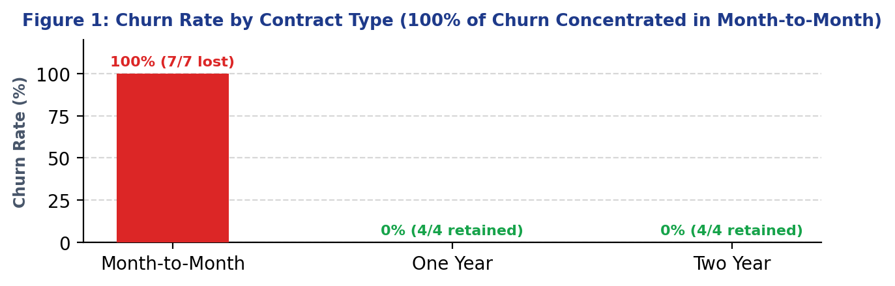
MATERIAL INSIGHT 1 / 5
Insight 1: Contract Commitment Architecture is a Binary Churn Driver
Key Empirical Takeaway:
100% Churn Concentration:
Every single churned customer (7 of 7) was on a Month-to-Month agreement. Zero churn occurred on One-Year (4) or Two-Year (4) contracts.
Switching Barrier Mechanism:
Month-to-Month contracts carry zero structural friction. At the first sign of onboarding difficulty, accounts walk away at the next billing cycle.
Contracted Adoption Runway:
Annual and multi-year agreements provide Customer Success teams with a formal, contracted runway to resolve technical blockers and prove business value.
Material Executive Decision:
Discontinue standalone Month-to-Month contracts for mid-market Pro and Enterprise accounts. Require quarterly or annual minimums with onboarding value guarantees.

Slide 4
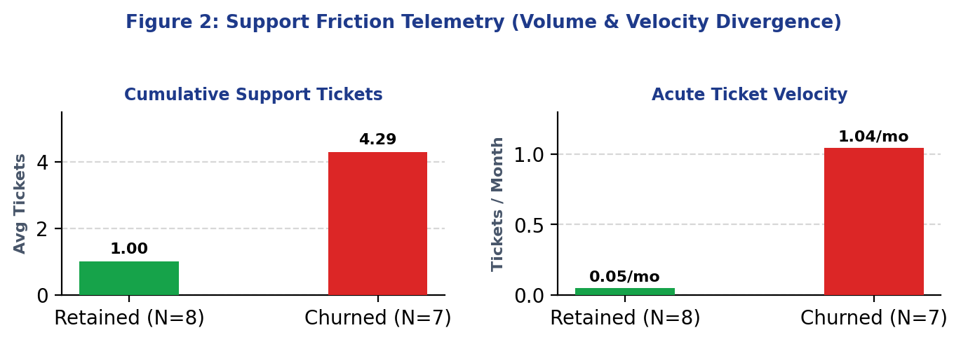
MATERIAL INSIGHT 2 / 5
Insight 2: Support Ticket Velocity is an Acute Leading Friction Indicator
Key Empirical Takeaway:
Volume & Velocity Divergence:
Retained accounts average 1.0 support ticket (max 2). Churned accounts average 4.29 tickets (range 3–6), logging 1.0 to 2.5 tickets/month during onboarding.
Operational Friction Signal:
Support tickets measure product friction and failed user expectations. When tickets exceed 3 within 60 days, customer frustration hardens into exit intent.
Automated Ticket Velocity Alarm:
Deploy real-time support monitoring: any account logging ≥3 tickets within 60 days or >0.5 tickets/mo triggers automated senior engineering escalation.
Material Executive Decision:
Mandate that Customer Success contact flagged accounts within 24 hours to schedule a 1-on-1 technical resolution call before intent hardens.

Slide 5
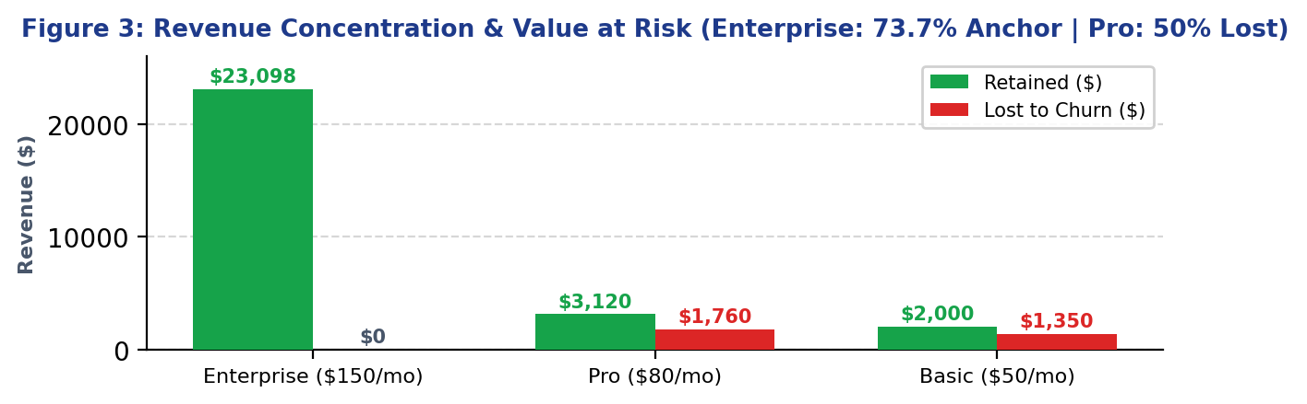
MATERIAL INSIGHT 3 / 5
Insight 3: High-Value Revenue Leakage in the Mid-Market Pro Tier
Key Empirical Takeaway:
50% Churn Rate in Pro Tier:
The Pro tier ($79.99/mo) has lost 2 of 4 accounts, forfeiting $1,919.76 in ARR and $1,759.78 in historical revenue from just two customer departures.
The Mid-Market Coverage Gap:
Pro users have complex workflows requiring support, but fall into a coverage gap: they lack dedicated Enterprise TAM coverage and cannot self-serve like Basic.
Friction Meets Month-to-Month:
Both churned Pro accounts (CUST-1005, CUST-1012) had 3–4 support tickets and were on Month-to-Month billing, creating immediate flight risk.
Material Executive Decision:
Establish a dedicated Pro Tier Onboarding Flight. Bundle senior engineering resolution with a 15% discount incentive to convert to annual agreements.

Slide 6
MATERIAL INSIGHTS 4 & 5
Insights 4 & 5: Enterprise Fortress & Early Onboarding Friction
Insight 4: Enterprise Anchor & Concentration Risk
• 73.7% Revenue Anchor: Enterprise accounts generate $23,098.46 of $31,327.18 total revenue with 0.0% churn and 38.5 months average tenure.
• Two-Year Stability: Locked in 2-year deals with dedicated account coverage and only 0.5 tickets per account.
• High Concentration Hazard: With nearly 3/4 of revenue in just 4 accounts, a single exit loses $1,800/yr ARR.
• Executive Action: Institute formal Quarterly Executive Business Reviews (EBRs) and begin renewal talks 6 months ahead.
Insight 5: Early Onboarding Drop-offs & Payment Friction
• 57.1% Early Churn: 4 of 7 churned accounts left in ≤6 months (avg 3.8 months tenure), averaging 5.0 tickets.
• Failure to Reach Value: Users fail to achieve 'time-to-value' in first 30 days, logging high support before dropping off.
• Payment Method Penalty: Debit Card had 100% churn (2/2) and UPI had 75% churn (3/4) vs 0% Bank Transfer and 33% Credit Card.
• Executive Action: Deploy interactive 14-day in-app onboarding checklist and offer 5% credit for automated ACH billing.

Slide 7
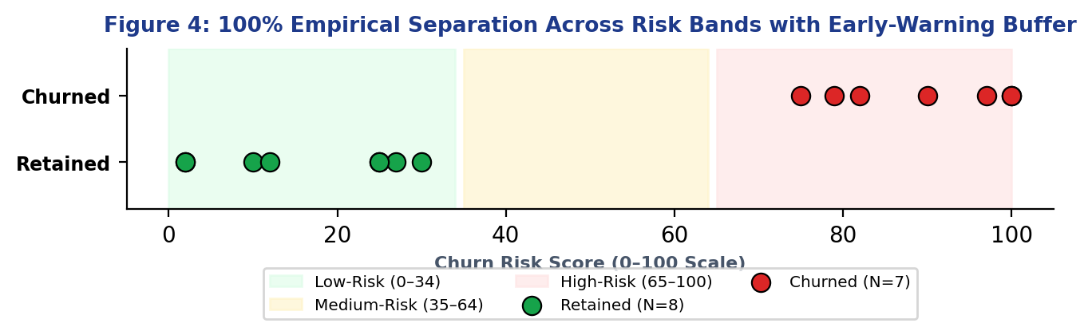
SCORING MODEL & VALIDATION
Explainable Churn-Risk Architecture: 0–100 Point Triage Engine
Additive 0–100 Point Architecture:
• Contract Commitment (Max 40 pts):
Month-to-Month = 40 | One-Year = 10 | Two-Year = 0
• Support Friction & Velocity (Max 35 pts):
Tickets ≥5 = 35 | Tickets 3–4 = 25 | Tickets 1–2 = 10 | Tickets 0 = 0 (Velocity trigger at ≥0.5/mo)
• Lifecycle Tenure (Max 20 pts):
≤6m (Onboarding) = 20 | 7–12m = 12 | 13–24m = 5 | >24m = 0
• Payment Channel (Max 5 pts):
Debit / Ad-hoc UPI = 5 | Credit Card = 2 | Bank Transfer = 0
Empirical Validation Result:
100% empirical separation: Churners scored 75–100 (Mean: 89.0), Retained scored 2–30 (Mean: 16.6). Establishes an operational 34-point Medium-Risk early-warning buffer.

Slide 8
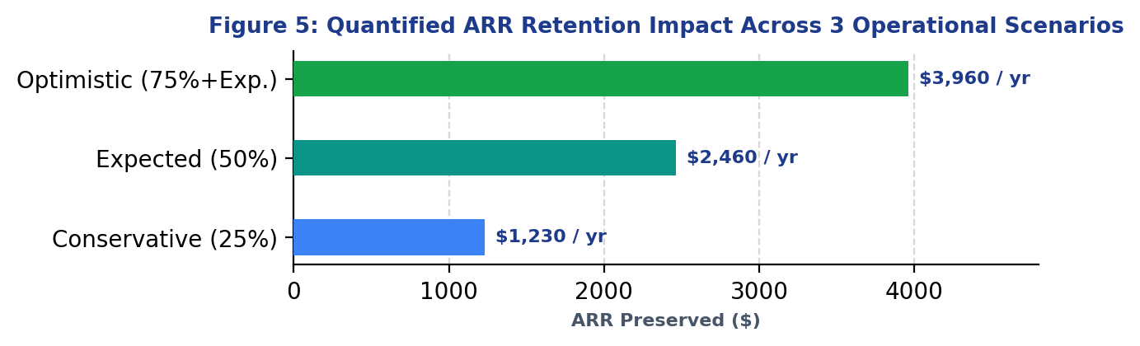
FINANCIAL MODELING & ROI
Quantified Financial Return: Saving $1,230 to $3,960 in ARR
12-Month Financial Return Modeling:
Conservative Scenario (+$1,230 ARR):
25% reduction in M2M churn; saves 1 Pro or 2 Basic accounts via automated support ticket alerts.
Expected Scenario (+$2,460 ARR):
50% reduction in churn; saves 1 Pro account ($960 ARR) and 2 early Basic accounts ($1,200 ARR) via CSM outreach and annual discounts.
Optimistic Scenario (+$3,960 ARR):
75% churn reduction across all cohorts plus 15% revenue expansion from migrating stable Basic users to Pro tiers.
ROI Break-Even Reality:
At an average customer lifetime value of $5,774 for Enterprise and $1,220 for Pro, preventing just a single mid-market churn event fully finances the entire automated ticketing infrastructure.

Slide 9
METHODOLOGY & LIMITATIONS
Analytical Transparency: Assumptions, Limitations & Governance
Model Assumptions & Preconditions
• Cohort Proportionality:
Assumes the 15 customer records reflect broader operational distribution of contract types and friction.
• Proxy Validity:
Cumulative tickets and tenure serve as effective proxies for user satisfaction and switching barriers.
• CSM Receptivity:
Assumes accounts flagged in Medium-Risk (scores 35–64) are receptive to proactive technical outreach.
• Commercial Willingness:
Assumes a subset of monthly users will accept annual discounts in exchange for contractual stability.
Operational Limitations & Guardrails
• Sample Cohort Size (N=15):
Deterministic rule engine works cleanly; higher-dimensional ML requires larger telemetry volume.
• Absence of Direct Telemetry:
Lacks in-app metrics (DAU/MAU, feature depth, session time); recommend instrumenting telemetry in Q1.
• Causality vs Correlation:
Month-to-Month contracts enable easy cancellation, but product setup friction causes the intent.
• Recalibration Governance:
Quarterly auditing of False Positives (>65 retained) and False Negatives (<35 churned) to tune weights.

Slide 10
STRATEGIC EXECUTION PLAYBOOK
Strategic Execution: 30–60–90 Day Roadmap & Executive Decision
Days 1–30: Immediate Triage
Halt Active High-Value Leakage
• Deploy Zendesk Support Velocity Alarm (≥3 tickets trigger).
• Conduct 1-on-1 CSM rescue calls with active Pro accounts.
• Assign senior engineering dispatch to resolve open tickets.
Days 31–60: Structural Reform
Re-Architect Contract Packaging
• Eliminate standalone Month-to-Month contracts for Pro.
• Roll out interactive 14-day in-app onboarding checklist.
• Offer 5% billing incentive for automated ACH / auto-pay.
Days 61–90: Enterprise Defense
Protect Revenue & Scale Telemetry
• Formalize Quarterly Executive Business Reviews (EBRs).
• Initiate renewal talks 6 months ahead of 2-year expirations.
• Automate weekly scoring updates and executive dashboards.
EXECUTIVE ACTION REQUIRED: Authorize Revenue Operations to implement the Zendesk Velocity Trigger and launch the Pro-Tier Annual Contract Transition Incentive Program.

